Slide 1



C++ RESTAURANT ORDER SYSTEM
SUBMITTED BY
Syed Hammad Hassan
ID: 45440
Asadullah Hussain
ID: 45359
C++ Restaurant Order System Project
1

Slide 2









📚 Learning Path
What We Will Learn
01
02
Basic Concepts
Variables
Headers & namespaces
Storing data
03
04
Student Learning Programming
Input/Output
Menu System
cin & cout
Choices & prices
05
06
Loops
Decisions
Repeating actions
Making choices
Students Coding Together
2

Slide 3





📝 Code Basics
Main Function & Variables
Your First Lines
int
main
()
{
int
n
,
item
;
int
total
=
0
;
}
int n
int item
How many items you want to order
The menu item number you choose
Programming Workspace
Your journey to building the restaurant order system starts here
3

Slide 4




💬 Communicating
Input & Output
cout
cin
cout
<< "How many items? “;
cin
>>
n
;
"
cout
<<
"Menu:\n"
;
Remember
cout = Output to screen
cin = Get user input
4

Slide 5
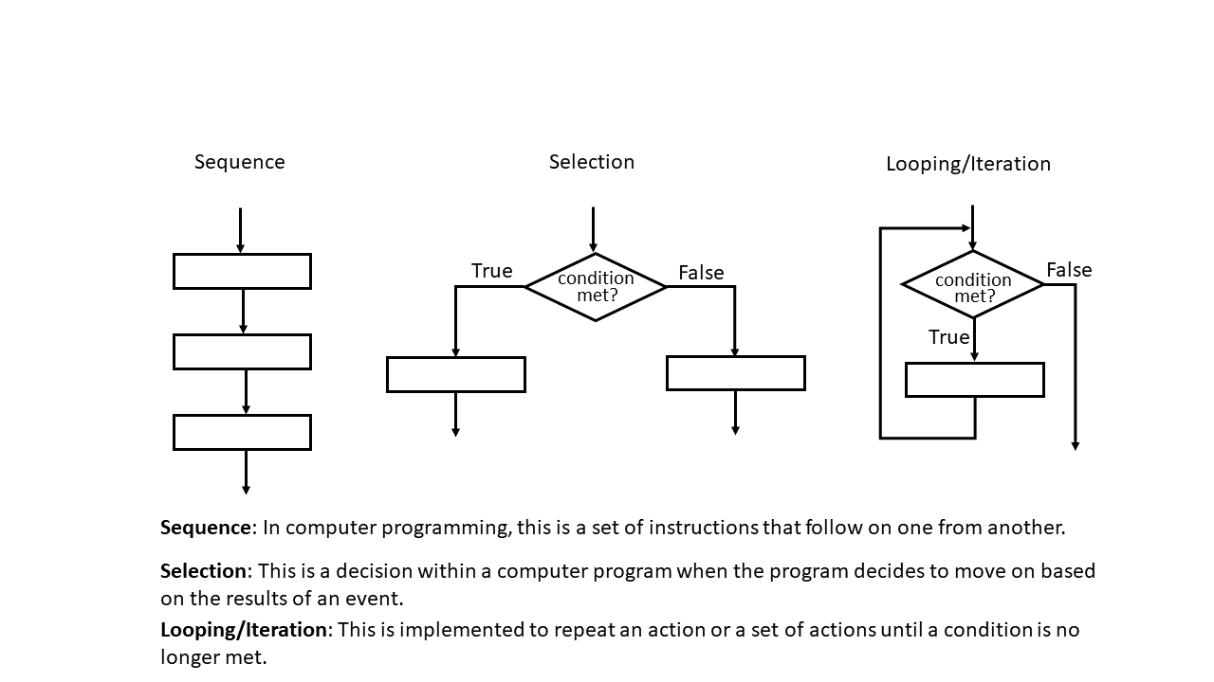


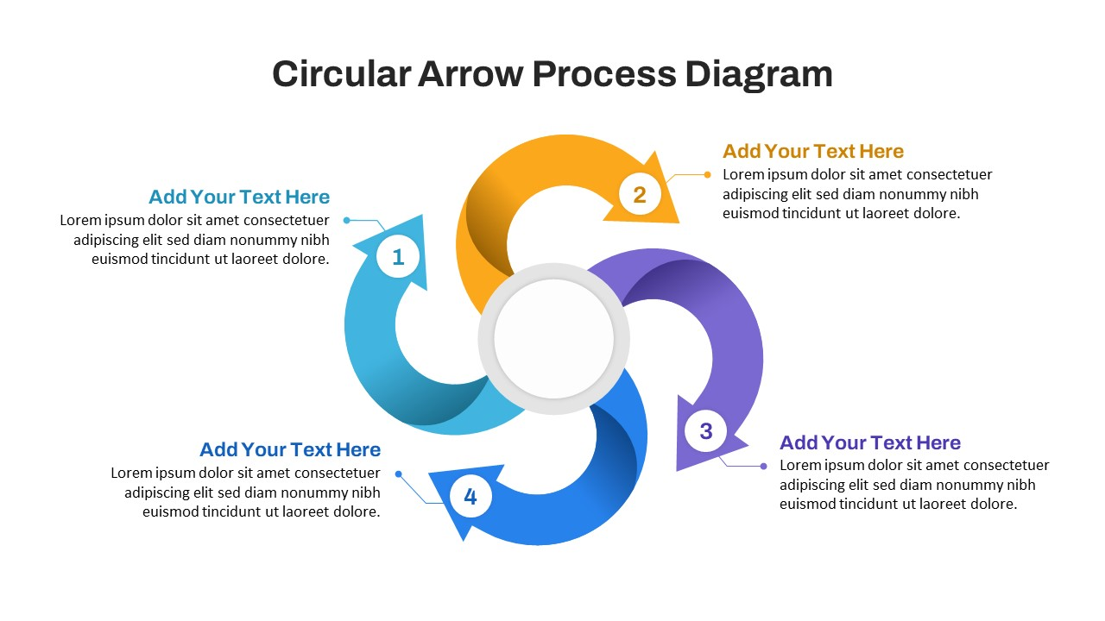

📝 Program Flow
How Program Works
Display Menu
1
Show choices to user
cout << "Menu"
Get Selection
2
User enters their choice
cin >> item
Show Bill
3
Display final total
cout << "Total:" << total
5

Slide 6

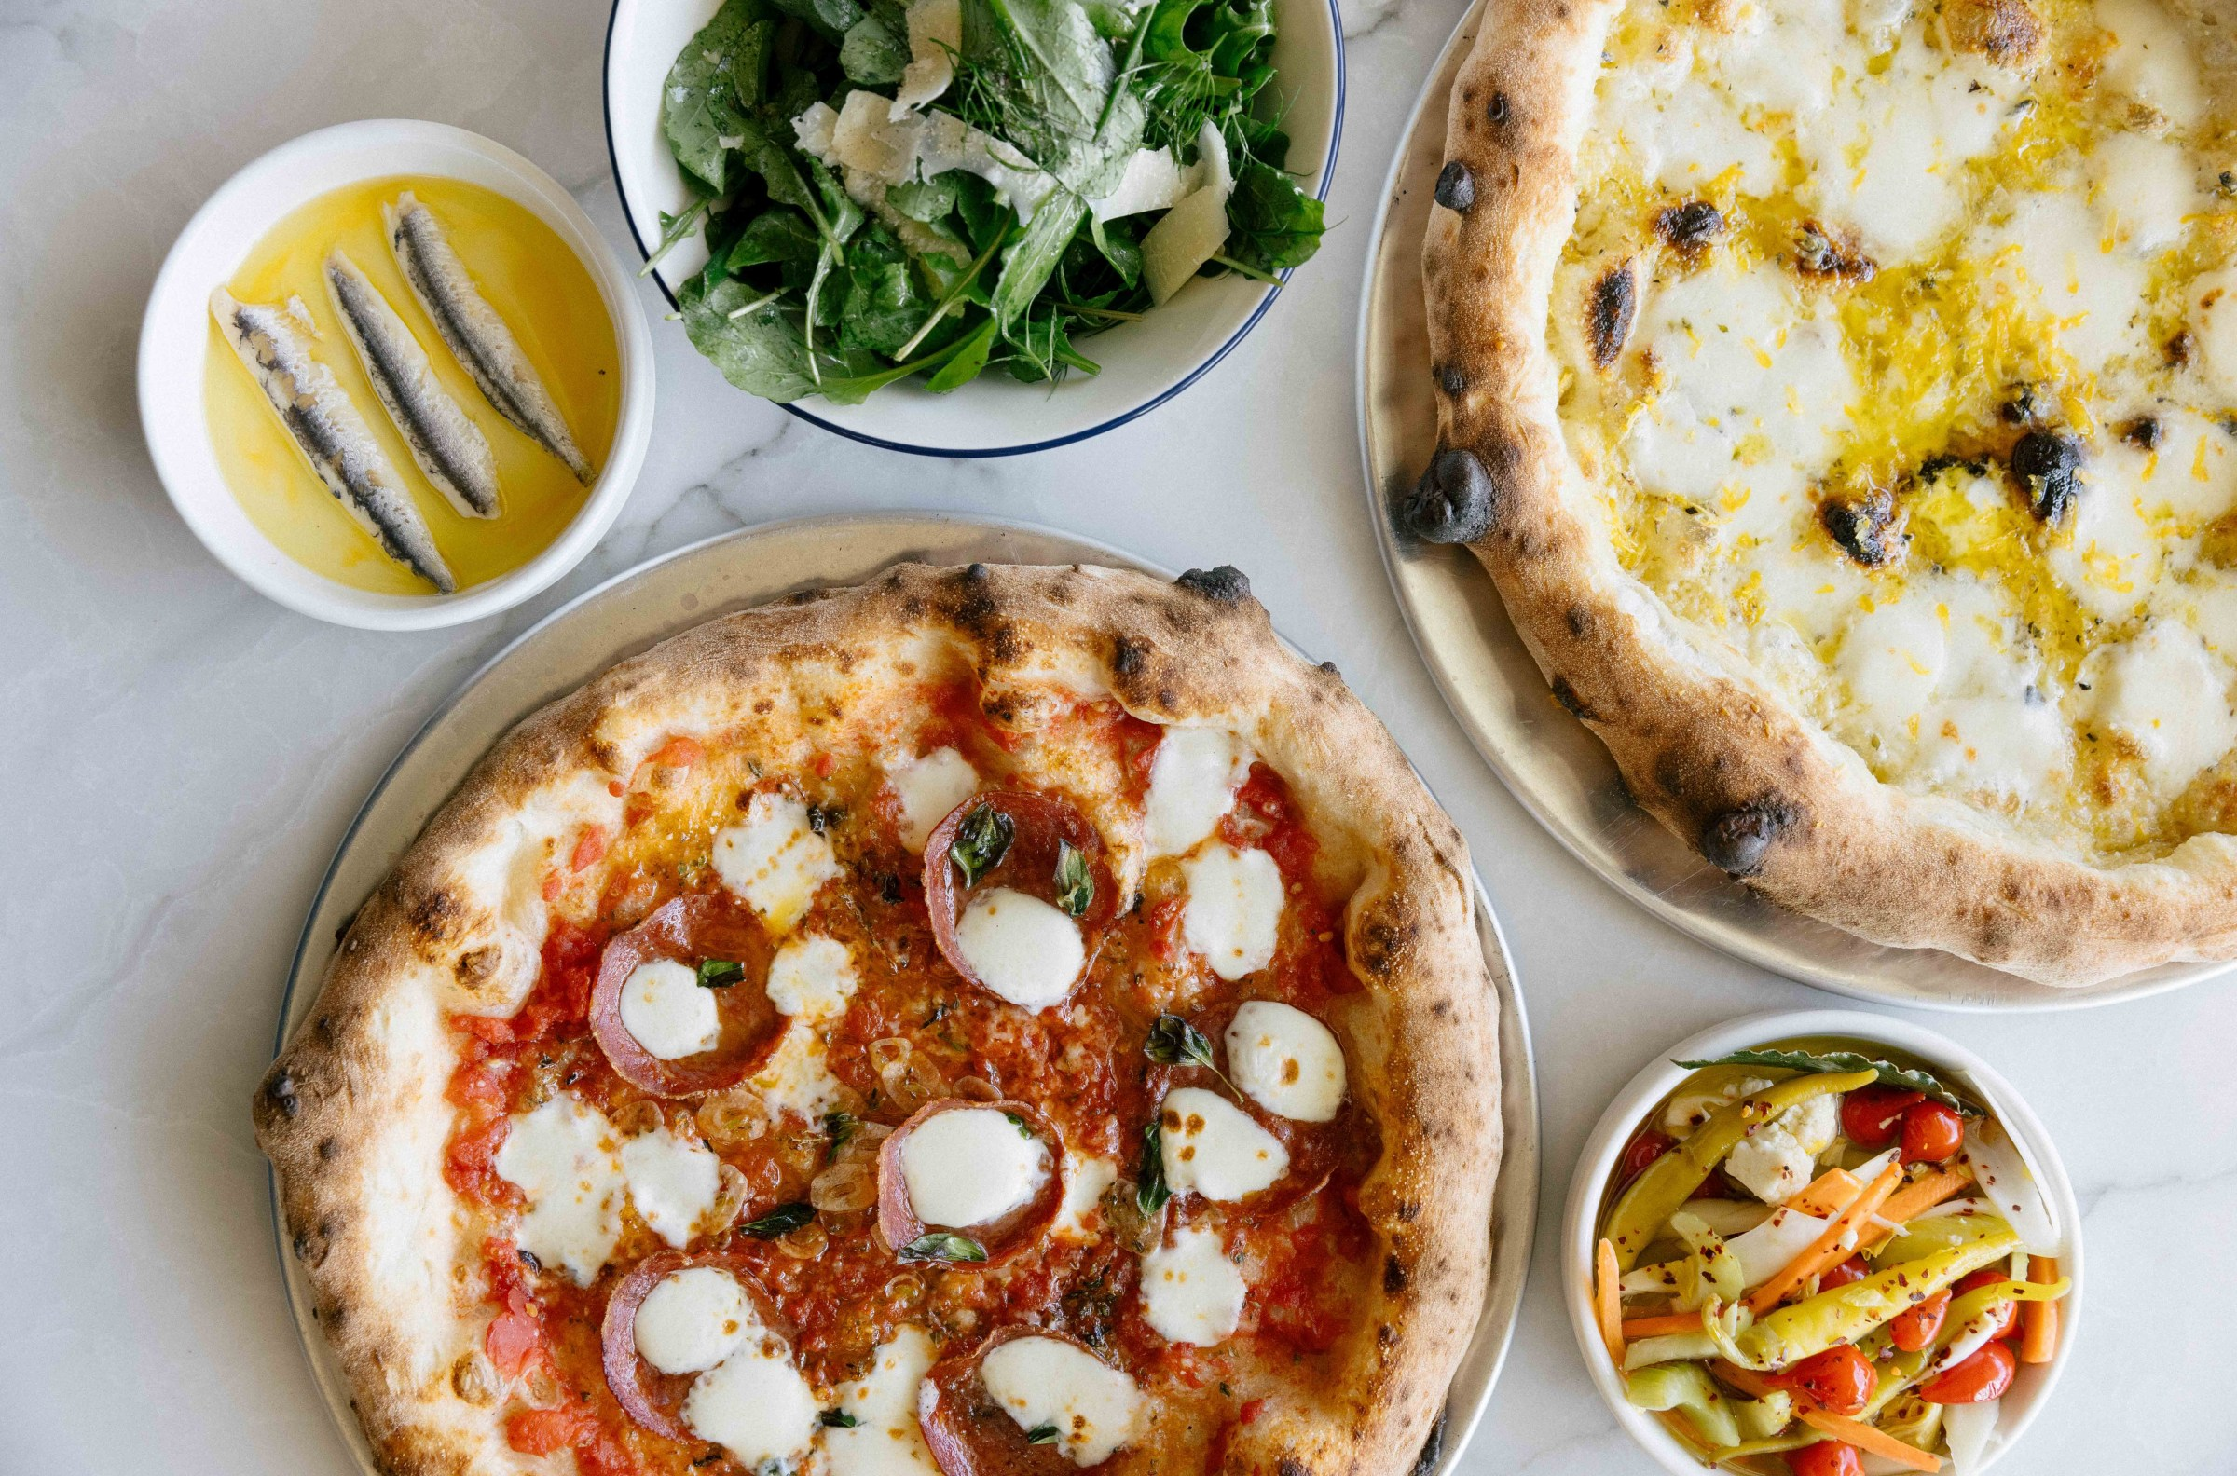

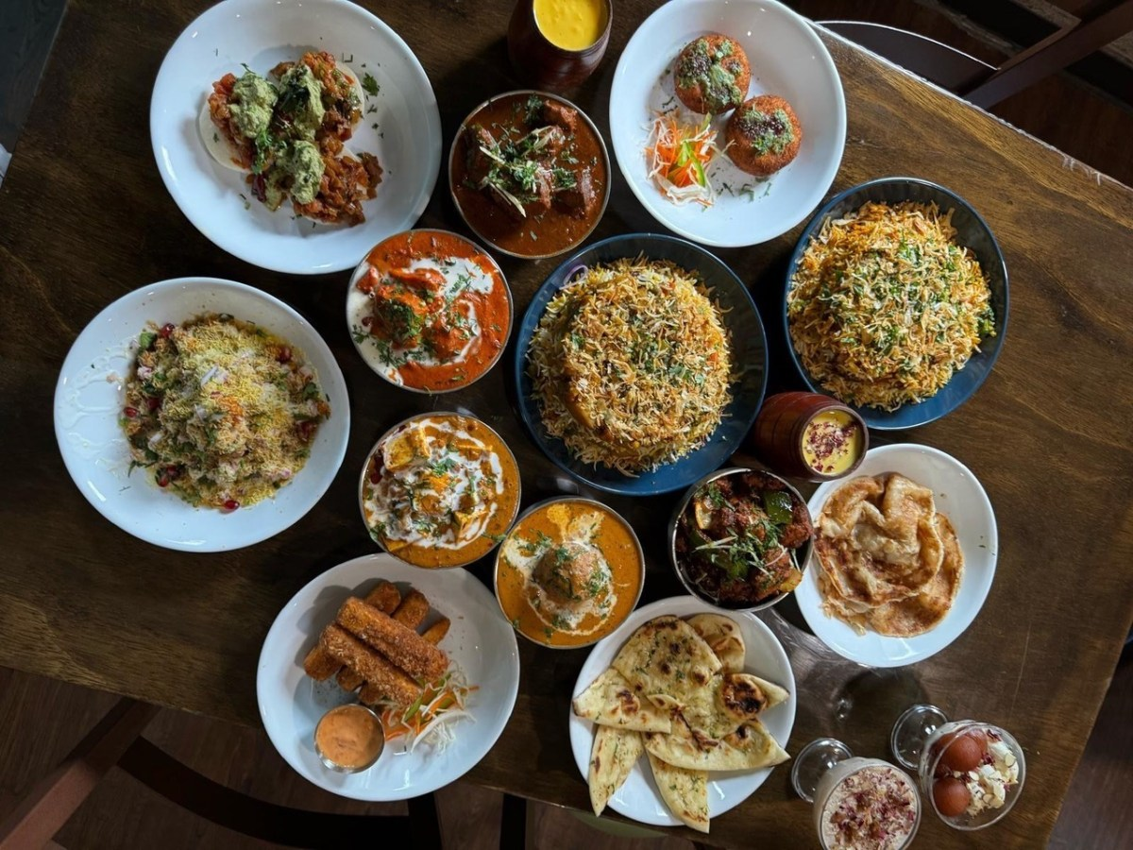

🍽️ Menu Selection
Delicious Choices at Great Prices
1
Anda + Paratha + Chai
2
Chana + Paratha + Chai
300 Rs
350 Rs
3
Chai
4
Beef Karahi
80 Rs
1800 Rs
Authentic Flavors
From traditional to contemporary dishes
5
Chicken Karahi
6
Cold Drink
1200 Rs
80 Rs
7
Roti
8
Naan
10 Rs
20 Rs
Fresh & Delicious
6
Made with premium ingredients

Slide 7

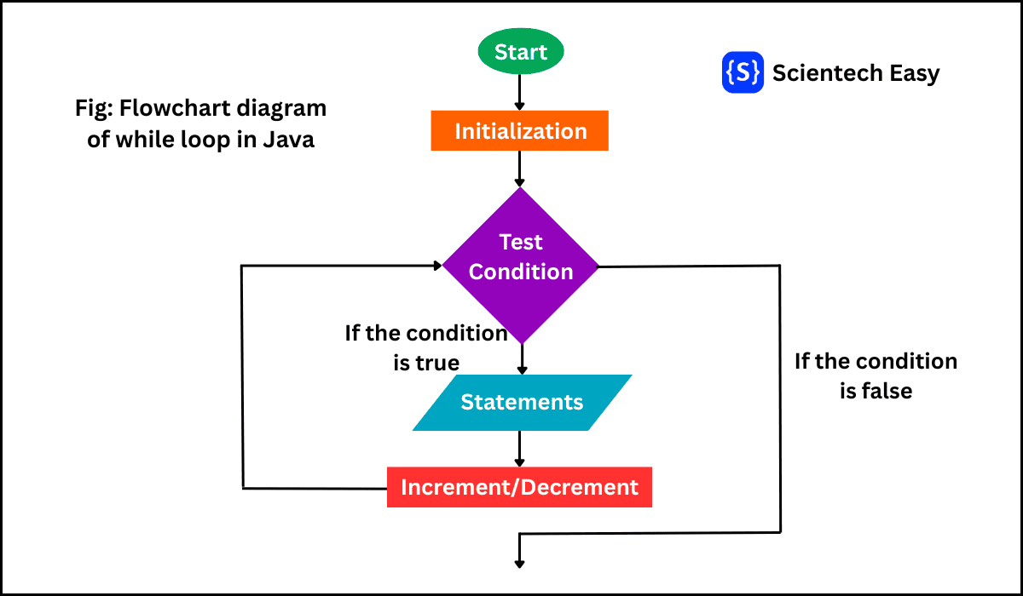

🔄 Repeating Actions
For Loop Structure
Loop Structure
for
(
int
i
=
1
;
i
<=
n
;
i
++) {
total += price;
}
Loop Flowchart
1
Initialize
2
Check
Start at 1
Is i ≤ n?
3
Execute
4
Increment
Run code
Add 1 to i
Iteration Process
7

Slide 8







🎯 Decision Making
if-else Statement
Decision Tree
if
(
item
==
1
)
total
+=
300
;
else if
(
item
==
2
)
total
+=
350
;
else if
(
item
==
3
)
total
+=
80
;
Item 1
Item 2
Add 300 Rs
Add 350 Rs
Item 3
Invalid
Add 80 Rs
Show error
8

Slide 9





💻 Working Program
The Complete Code
Restaurant Order System
#include
using namespace
std
;
int
main
()
{
int
n
,
item
;
int
total
=
0
;
Headers
cout
<<
"How many items do you want to order? ";
cin
>>
n
;
"Menu:\n"
cout
<<
endl
;
iostream
cout
<<
"Menu"
<<
endl
;
cout
<<
"1: Anda + Paratha + Chai (300)"
<<
endl
;
cout
<<
"2: Chana + Paratha + Chai (350)"
<<
endl
;
==
cout
<<
"3: Chai (80)"
<<
endl
;
cout
<<
"4: Beef Karahi (1800)"
<<
endl
;
Variables
"
cout
<<
"5: Chicken Karahi (1200)"
<<
endl
;
cout
<<
"6: Cold Drink (80)"
<<
endl
;
int n, item, total
cout
<<
"7: Roti (10)"
<<
endl
;
<<
==
cout
<<
"8: Naan (20)"
<<
endl
;
else if
item
for
(
int
i
=
1
;
i
<=
n
;
i
++
)
{
cout
<<
"\nEnter item number "
<<
i
<<
": "
;
(
+=
cin
>>
item
;
if
(
item
==
1
)
{
Loops
else if
=
total
=
total
+
300
;
total
}
else if
(
item
==
2
)
{
for loop
else if
total
=
total
+
350
;
else if
}
else if
(
item
==
3
)
{
item
total
total
=
total
+
80
;
80
}
else if
(
item
==
4
)
{
else if
item
total
=
total
+
1800
;
}
else if
(
item
==
5
)
{
Conditions
7
total
=
total
+
1200
;
total
}
else if
(
item
==
6
)
{
if-else
)
i
total
=
total
+
80
;
(
}
else if
(
item
==
7
)
{
total
=
total
+
10
;
}
else if
(
item
==
8
)
{
total
=
total
+
20
;
6
}
else
cout
<<
"Invalid item!"
<<
endl
;
}
cout
<<
"Total Bill = "
<<
total
<<
" Rs"
<<
endl
;
return
0
;
"
cut
<<
<<
total
<<
;
;

Slide 10



📊 Program Output
Sample Results
Terminal Output
How many items?
3
Menu:
Enter item 1: 1
✓ Added
Enter item 2: 5
✓ Added
Enter item 3: 3
✓ Added
Total Bill = 1580 Rs
3
1580
0
Items Ordered
Total (Rs)
Errors
10

Slide 11


Thank You!
Questions & Answers
Feel free to ask anything!
1
1

